Slide 1


Report Portal
January 2019

Slide 2
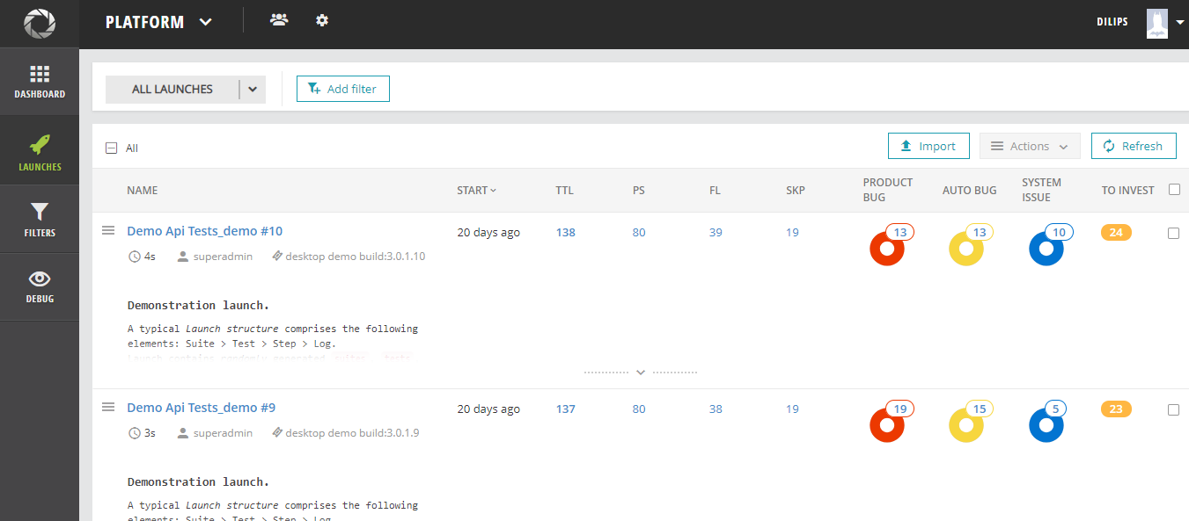
What is ReportPortal
Report Portal is an open-source tool that allows testers and key project stakeholders to manage and view all of their testing results and reports in one place.

Slide 3
How it can help us?
Manage all your automation results and reports in one place
Make automation results analysis actionable & collaborative
Establish fast traceability with defect management
Accelerate routine results analysis
Visualize metrics and analytics

Slide 4
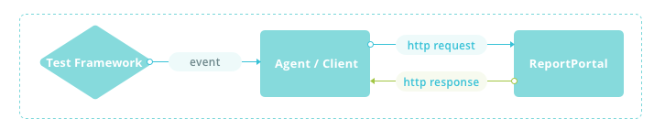
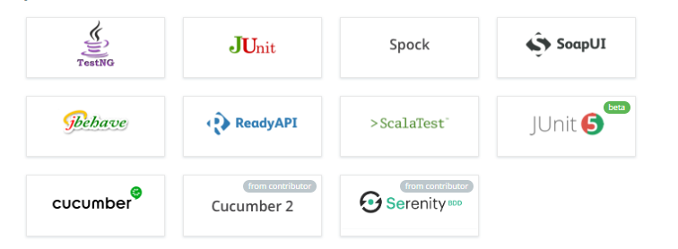
Integration and support for different frameworks

Slide 5
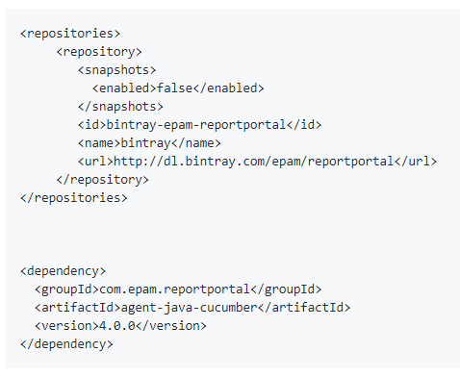
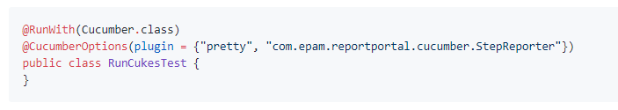
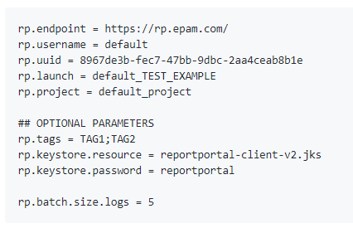
Cucumber Integration example
Add maven dependency
Attach to runner
Add reportportal.properties file
1
2
3

Slide 6
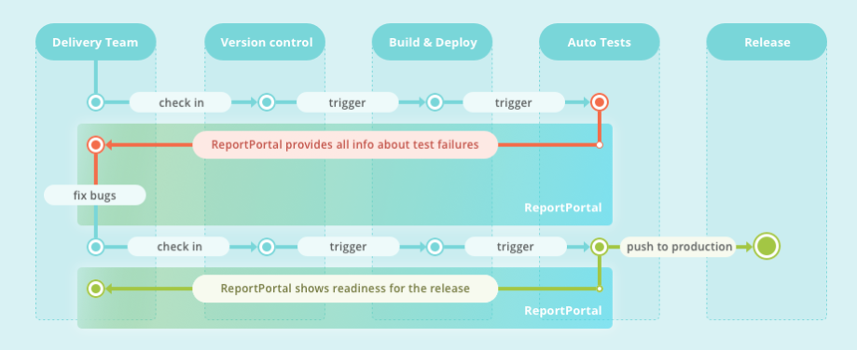
How does it integrate in my testing process?

Slide 7
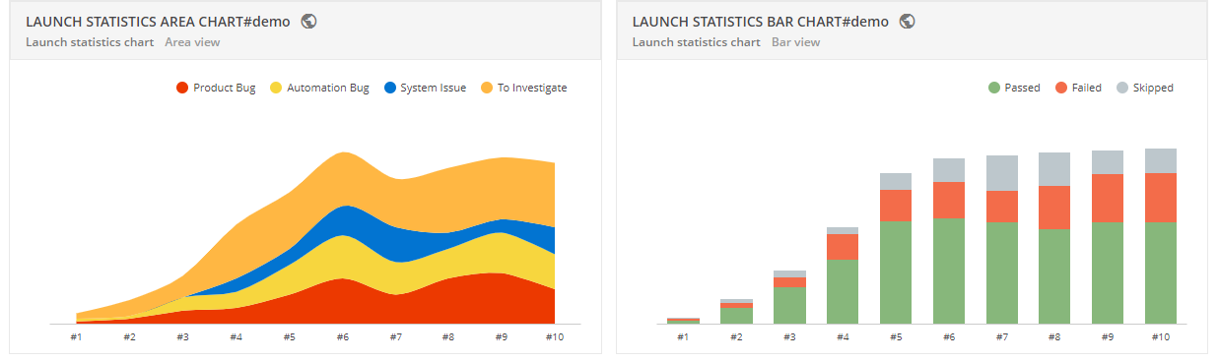
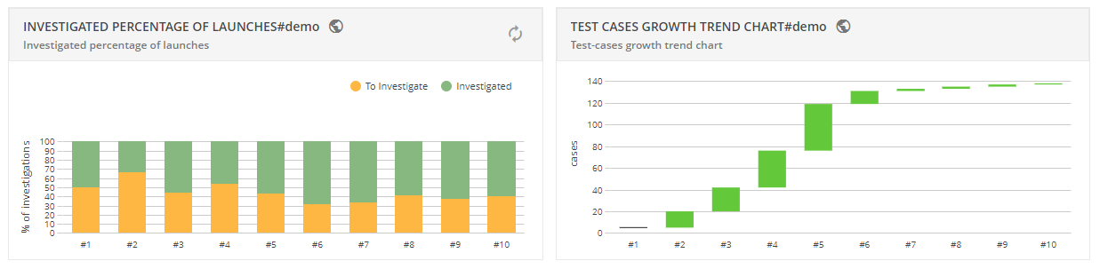
ReportPortal Dashboard

Slide 8
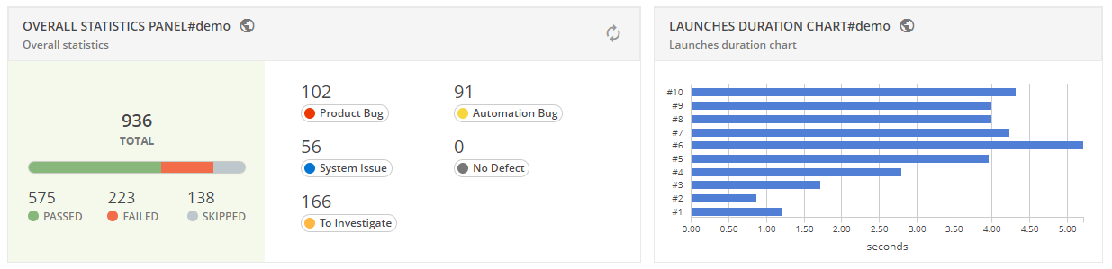
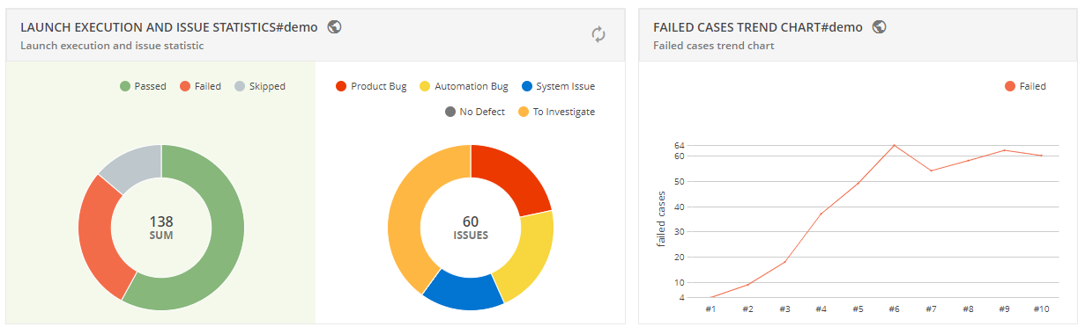
ReportPortal Dashboardcontinued...

Slide 9
PACT
January 2019

Slide 10
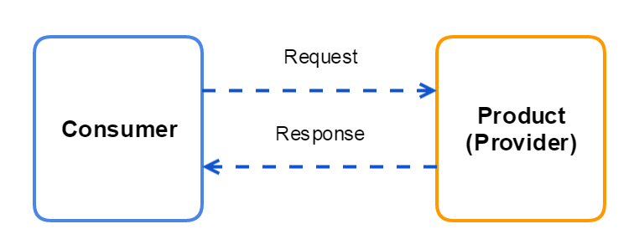
What is Contract testing
Contract testing is a way to ensure that services (such as an API provider and a client) can communicate with each other. Without contract testing, the only way to know that services can communicate is by using expensive and brittle integration tests.

Slide 11
What is PACT
A contract between a consumer and provider is called a pact. Each pact is a collection of interactions. Each interaction describes:
An expected request - describing what the consumer is expected to send to the provider (this is always present for synchronous interactions like HTTP requests, but not required for asynchronous interactions like message queues)
a minimal expected response - describing the parts of the response the consumer wants the provider to return.

Slide 12
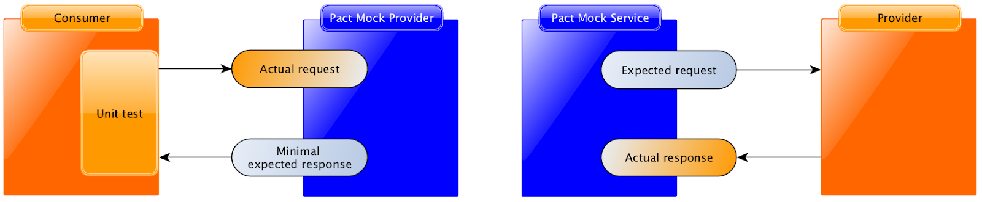
How PACT works?
Each interaction is tested using the pact framework, driven by the unit test framework inside the consumer codebase:

Slide 13
How PACT works? continued
Using the Pact DSL, the expected request and response are registered with the mock service.
The consumer test code fires a real request to a mock provider (created by the Pact framework).
The mock provider compares the actual request with the expected request, and emits the expected response if the comparison is successful.
The consumer test code confirms that the response was correctly understood

